Slide 1
Website Gil Peled

Slide 2
The Process
Step 1: Version 0
-Gil comes with a rough draft to generate ideas for website or a page
Step 2: Feedback and Updates
-Others provide feedback and make suggestions about what they want
-Turns ugly website into pretty website
Step 3: Make edits to a mostly polished version
-Calibrate numbers
-Polishes text and adds sources and relevant links to doctors
Step 4: Publish to the Internet

Slide 3
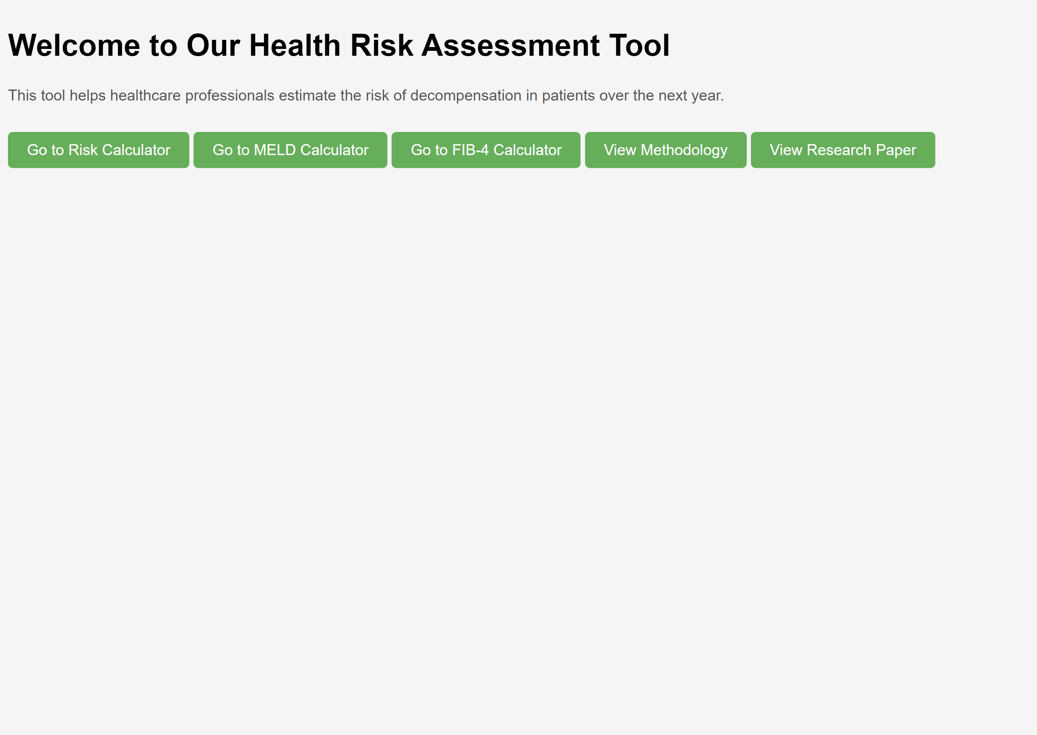
Home Page
Gil’s Thoughts:
This is ugly, I want to avoid over engineering the website though. I think a grey-tone or industrial looking will be better than trying to have a pop-y and image-filled website
If we have only a Risk calculator for hepatologists to play with this website may not be interesting enough to hepatologists and no one will ever visit it, so what other things should we have?
Lab aggregates (like MELD and FIB-4 and a dozen others) are easy to code, but they have low value since many websites already exist. More importantly these aggregates may not really be actionable or interesting to clinicians
Feedback: What are 10-20 things that would be on a wish-list to make you (a hepatologist) want to visit this website

Slide 4
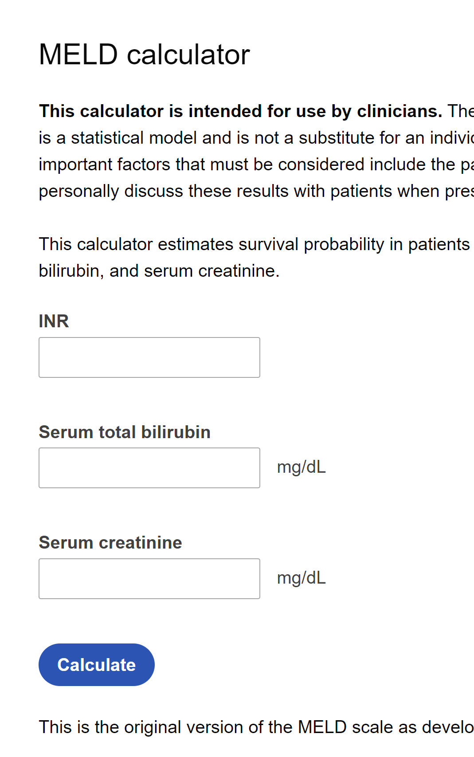
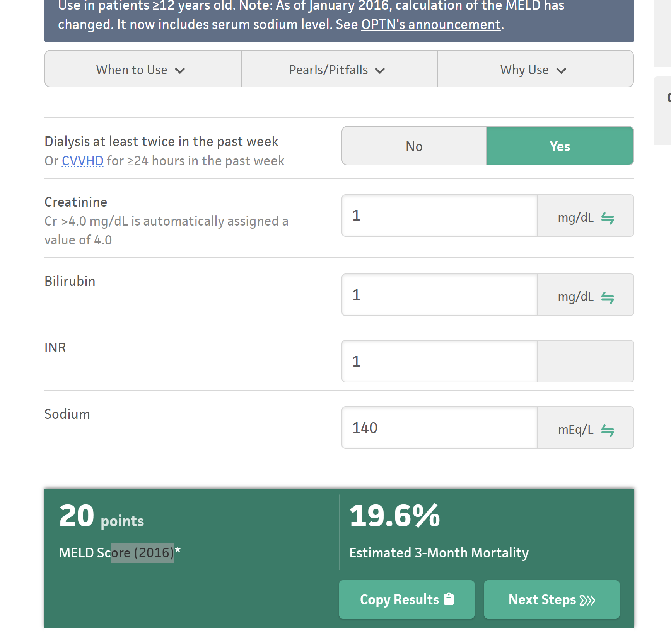
MELD Examples
Do we value this simplicity?
Should we report estimated mortality?

Slide 5
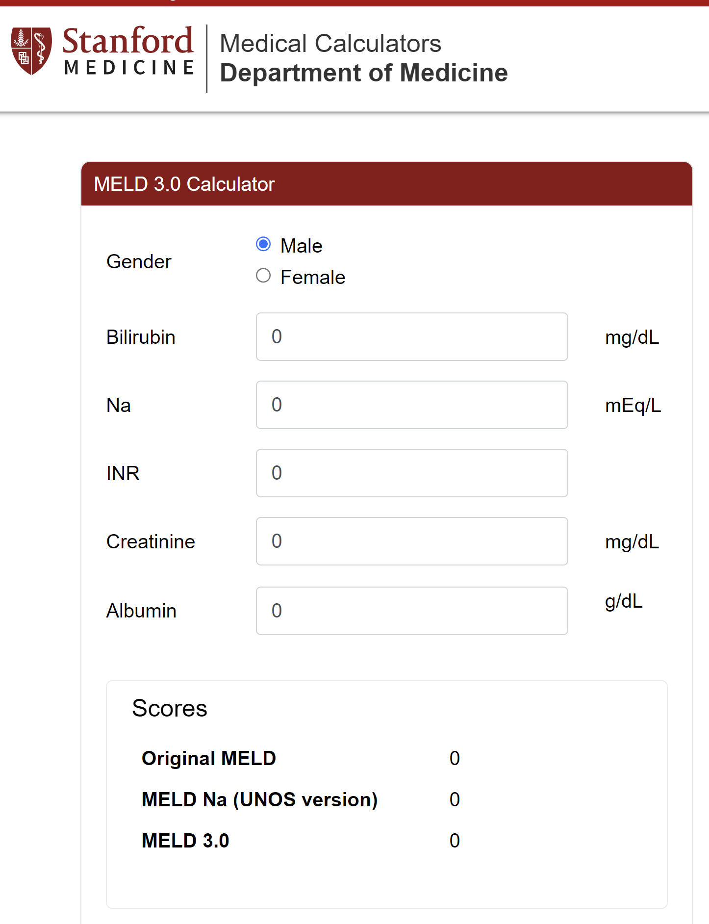
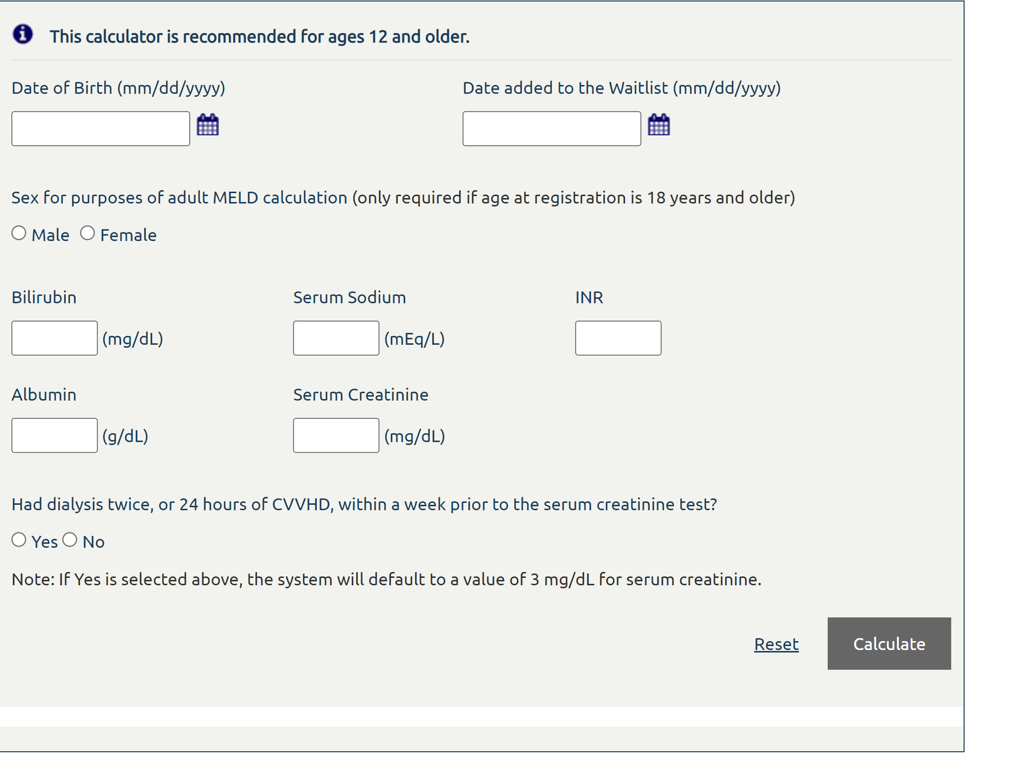
MELD Examples
Do we want to make this connection with liver transplant explicit?
See how it gives all the scores at the same time… is this nice

Slide 6
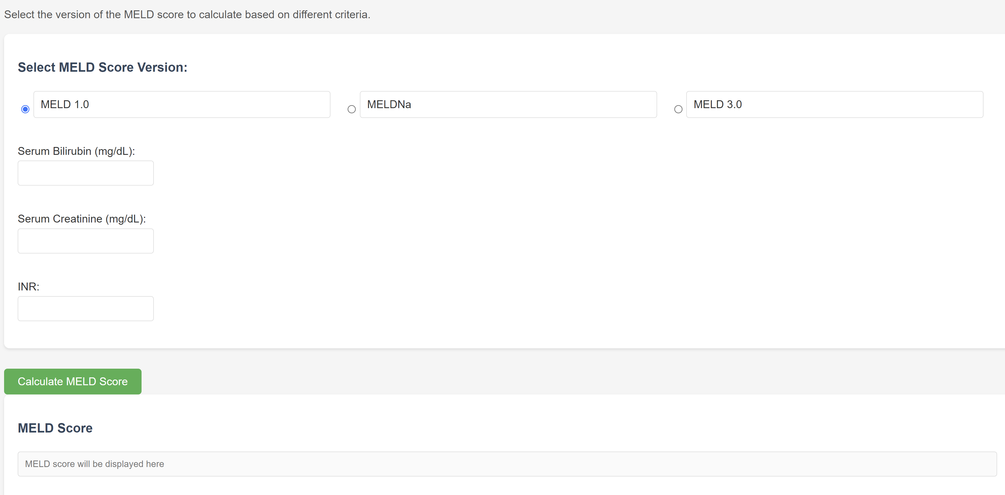
Our MELD Calculator
The Meld Score Version Allows for Various Choices see next slide
This slide is MELD 1.0 Next slide is MELD 3.0

Slide 7
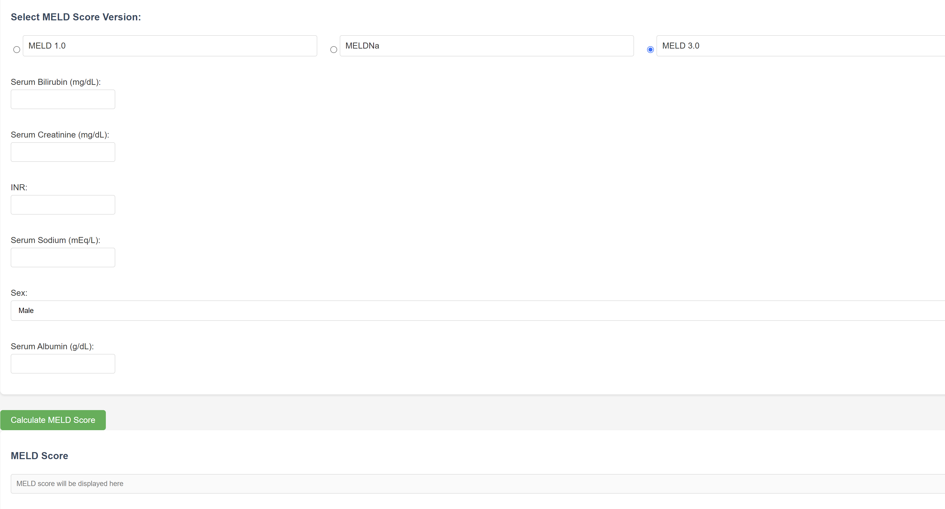
Our MELD Calculator
Gil’s Thoughts:
Even without feedback I know how to make this website better
How should we present the results. Should we include information from other research papers?
Should we present information on how MELD connects to things like mortality and liver transplantation
Feedback: What would you like to see on a MELD calculator?
The Meld Score Version Allows for Various Choices see next slide

Slide 8
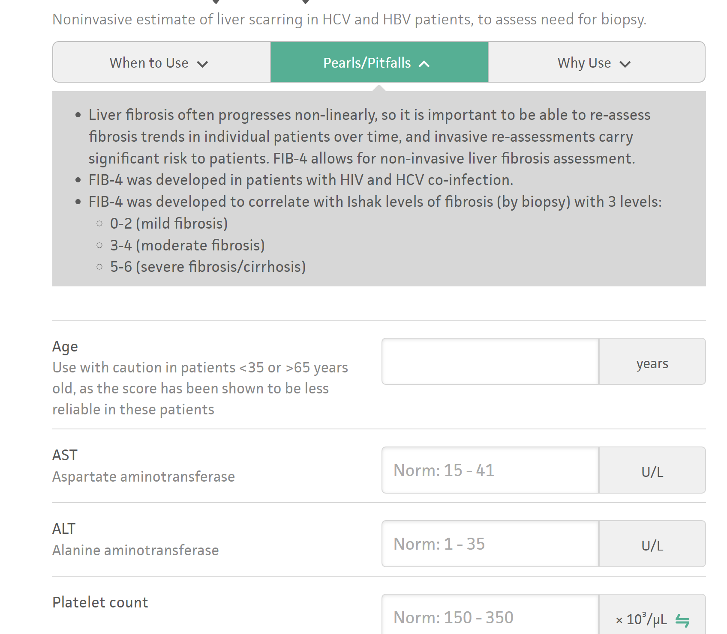
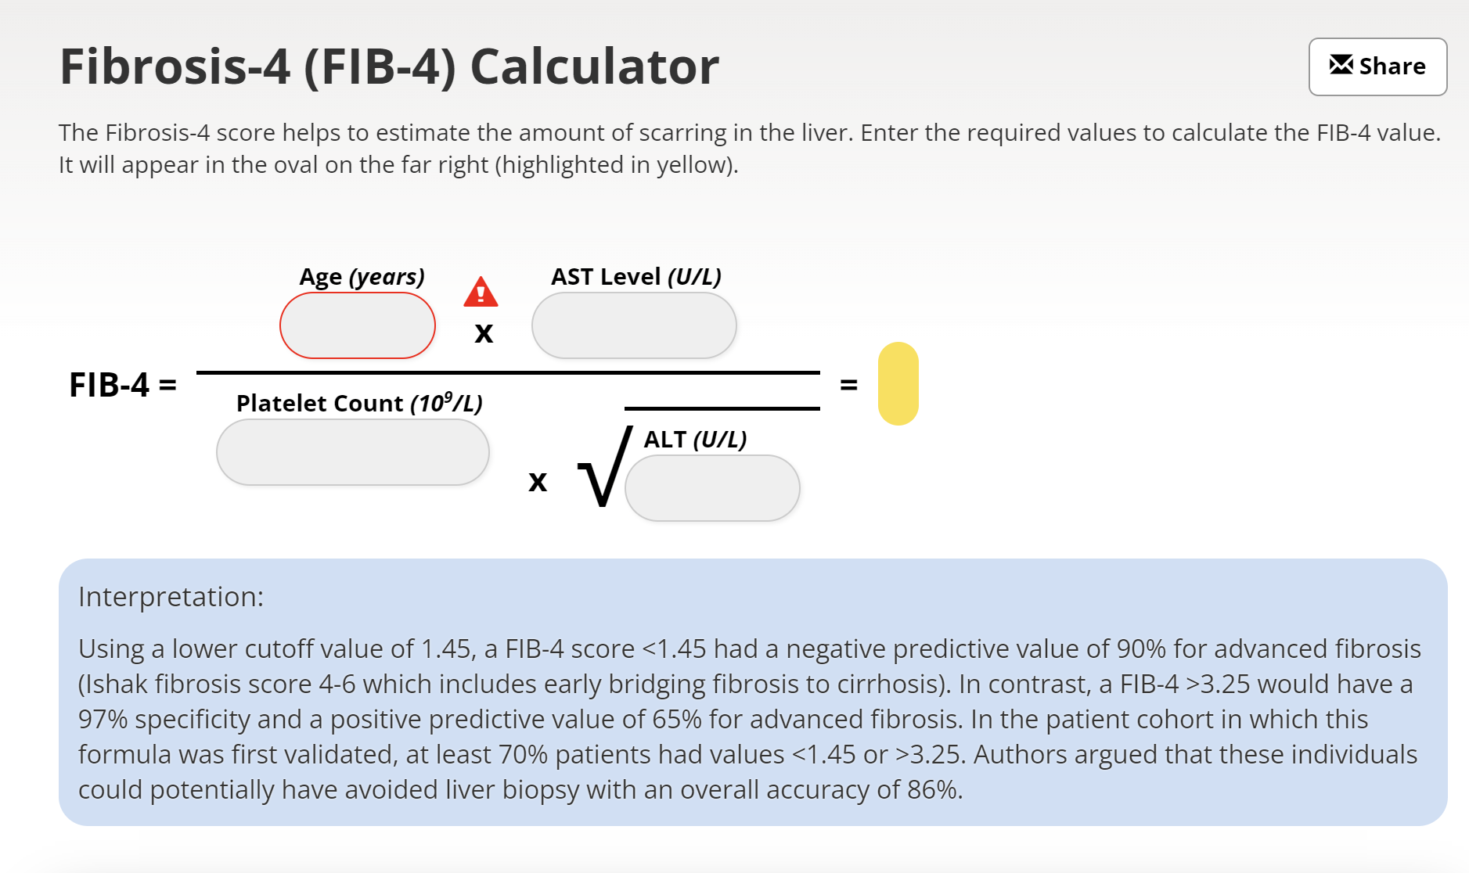
Fib4 Examples
Do we like showing this formula and inputting into this interactive format?
Should we include interpretation
Should we include info in top panel “when to use”, “pitfalls”, “why use”?

Slide 9
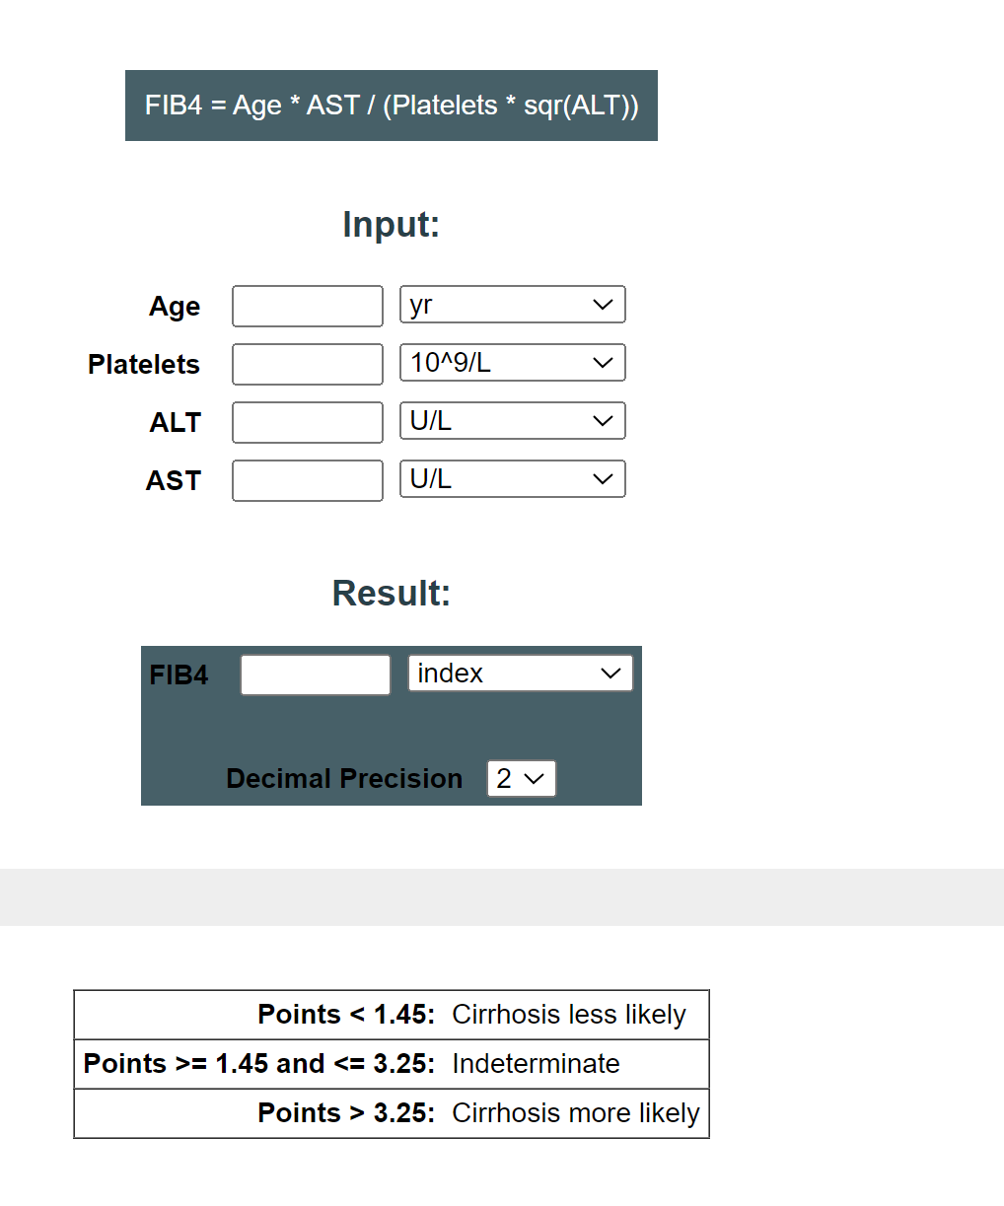
Fib4 Examples
This is simple example

Slide 10
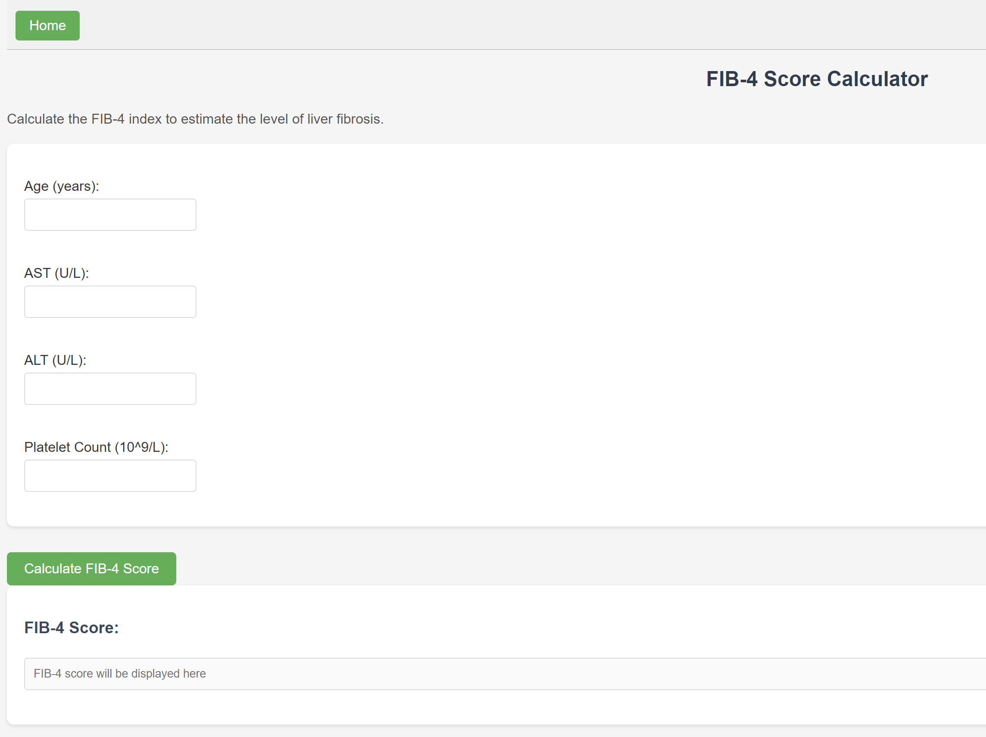
Our Fib-4 calculator
Gil’s Thoughts:
This is really simple. What do we want to have, see the previous examples

Slide 11
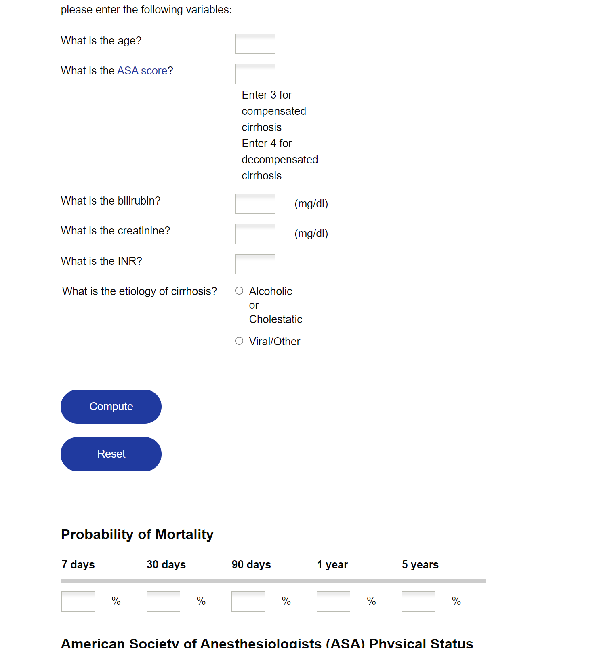
Outcome Calculator - Ideas
Do we like the idea of a post operative mortality rate?
We can certainly do better than this, they don’t even say which operation they’re talking about

Slide 12
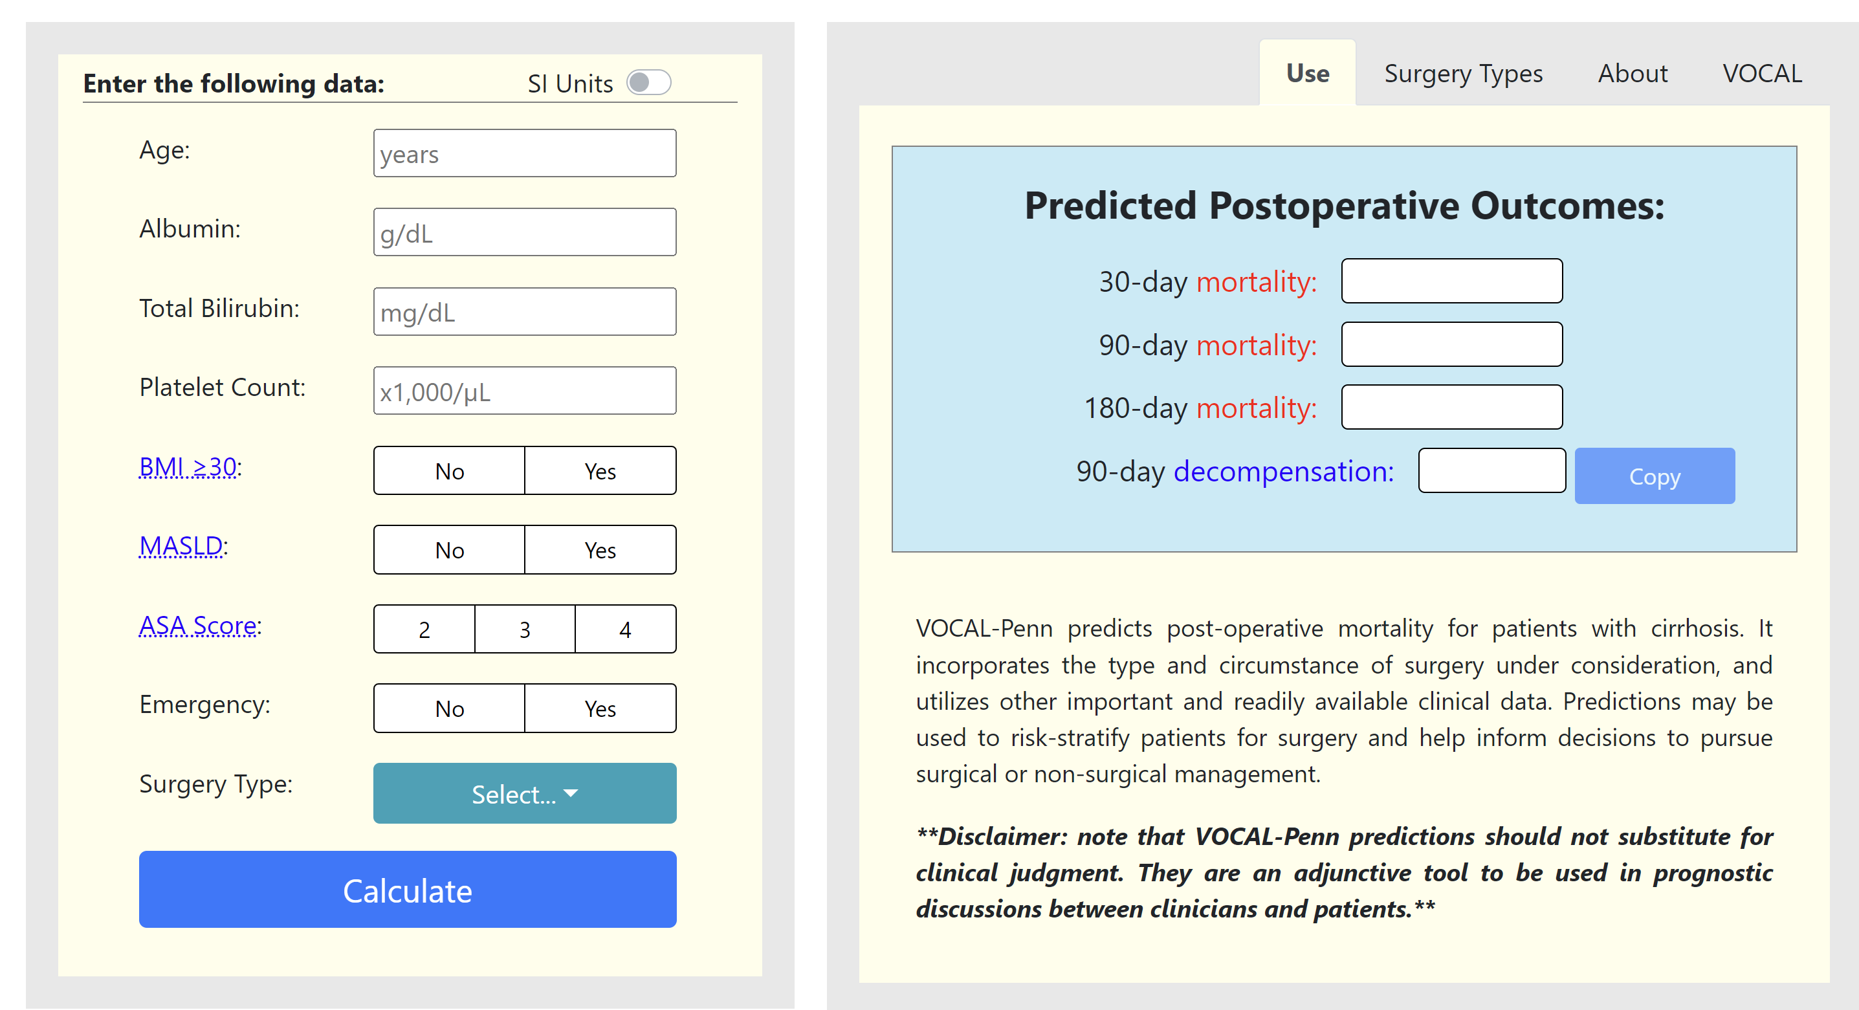
Outcome Calculator - Ideas
This is cool – I think. What parts of this do we like?

Slide 13
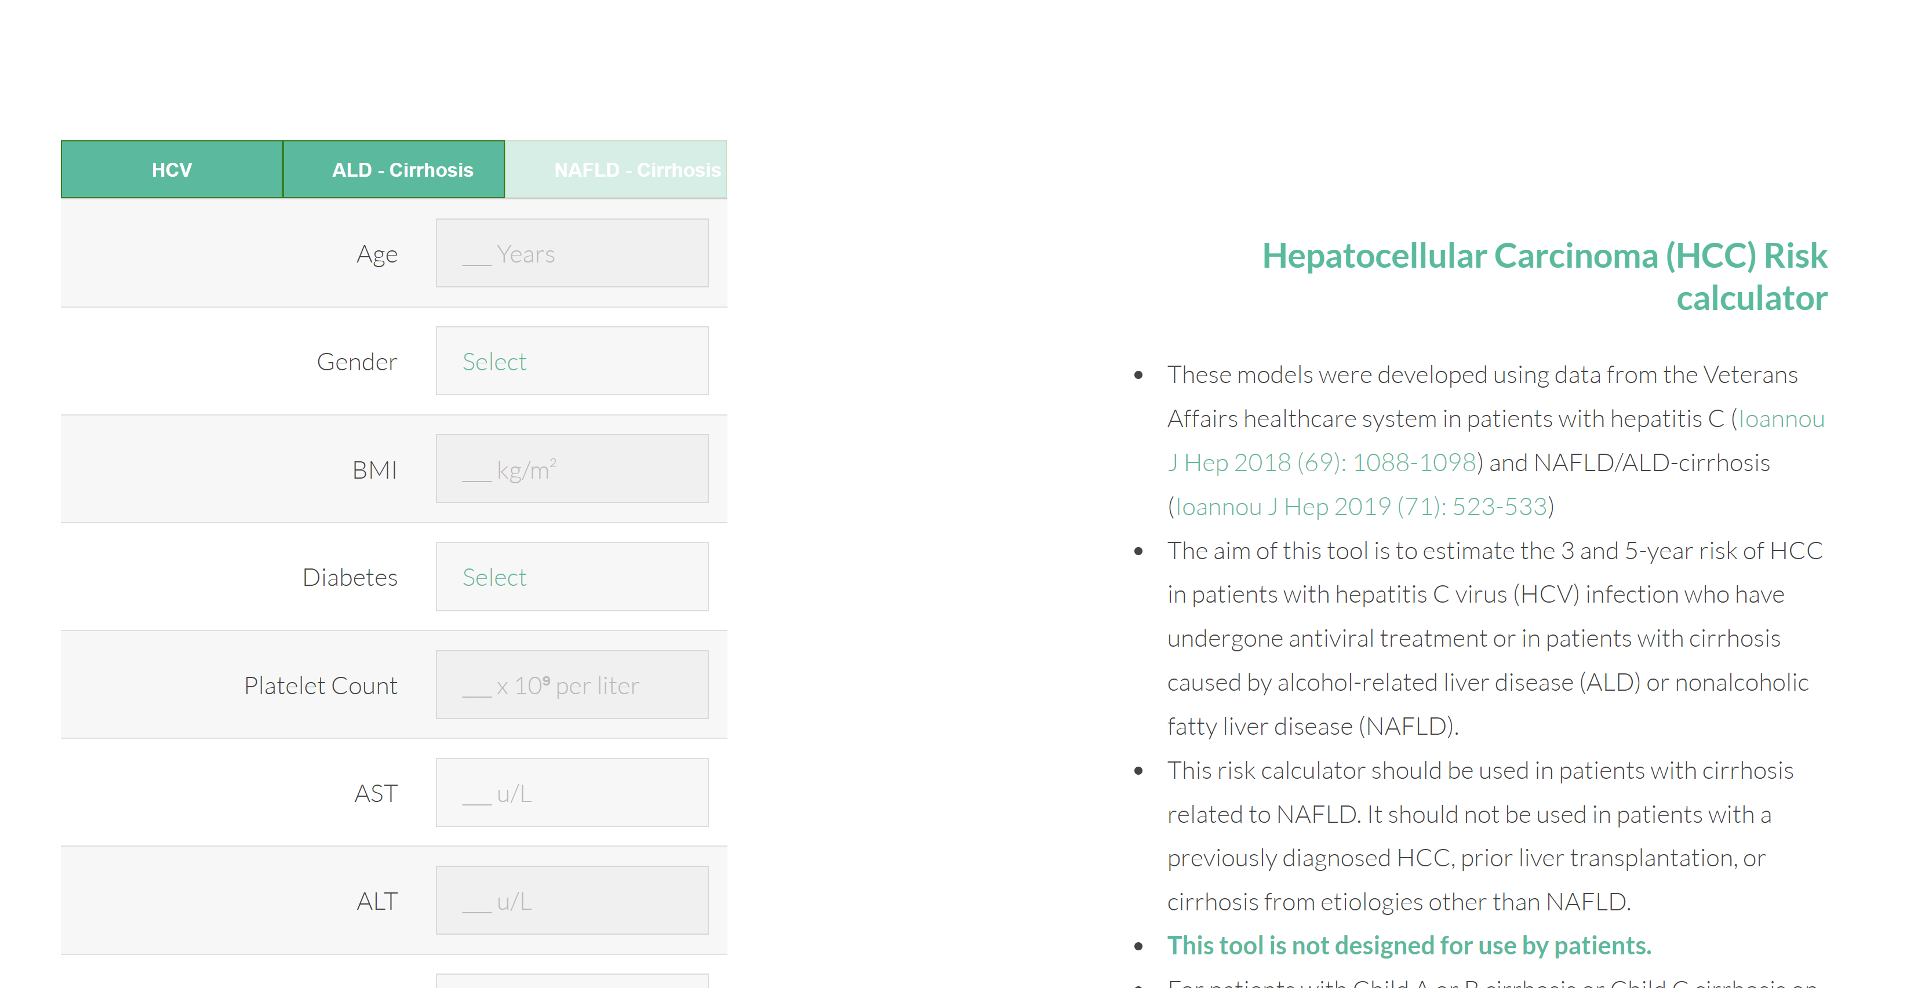
Outcome Calculator - Ideas
HCC calculator? How’s this for an idea?

Slide 14
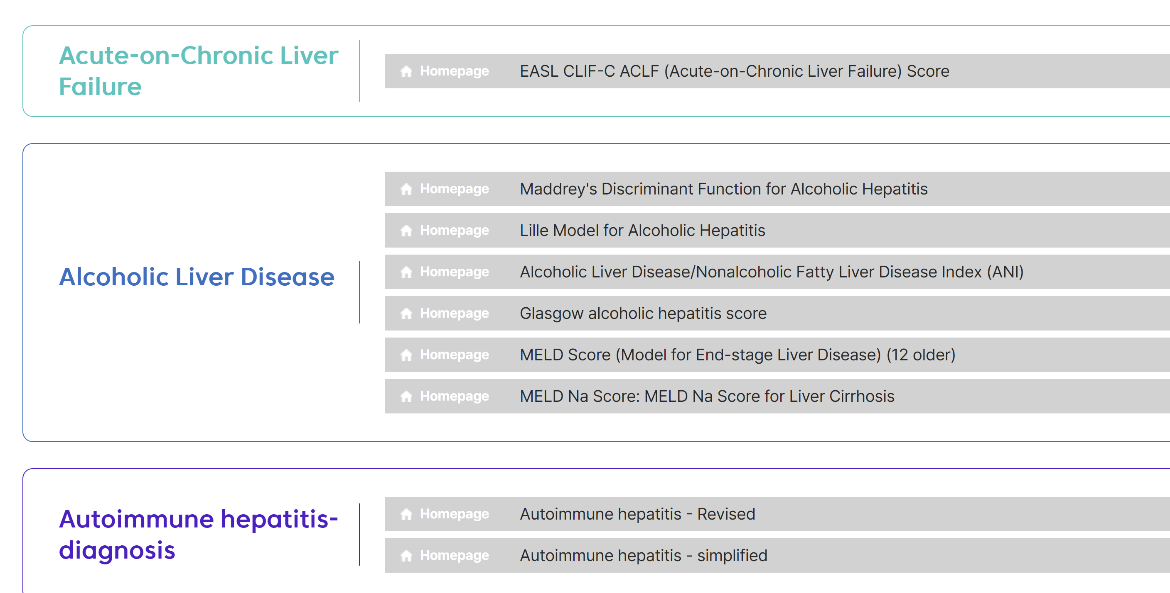
Rapid Fire List of Outcome calculator ideas
From the Korean Associate for the study of the liver

Slide 15
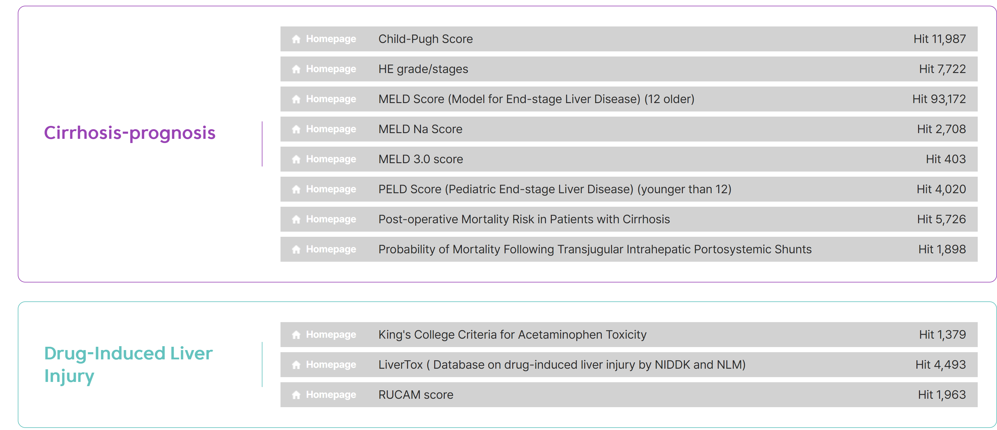
Rapid Fire List of Outcome calculator ideas
From the Korean Associate for the study of the liver

Slide 16
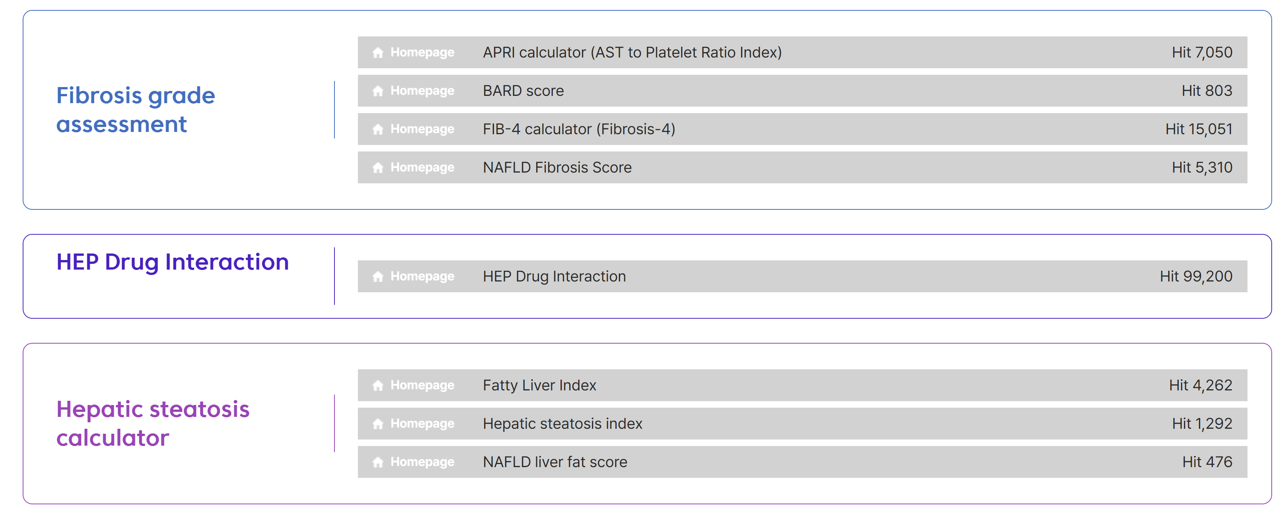
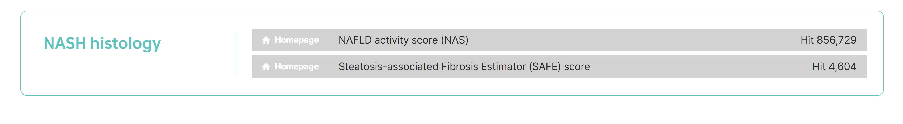
Rapid Fire List of Outcome calculator ideas
From the Korean Associate for the study of the liver

Slide 17
Our Risk Calculator
Next is the version 0 of the risk calculator
The calculator is functional but the values are fake
Math to be addressed:
How do we deal with missing values?
Most other calculators don’t allow missing values or are very restrictive of this
I suggest we simply use average or median values. So for example if gender isn’t provided we assume someone is 40% female and 60% male. If HCC isn’t provided we assume someone is 90% without HCC and 10% with HCC.
This isn’t mathematically true, but I think this is better and easier for a physician to play with rather than require that there are no missing values

Slide 18
Our Risk Calculator
It would be interesting to have the outcomes for a reference patient also presented. For instance the 1-year decompensation rate of a 64 year old MASLD patient….
Since we may think etiology is associated with every other covariate instead of including a (etiology x other covariate) interaction term in the equation, we can just estimates various logistic regressions that focus just on the HCV population, or just the MASLD population, etc… Federico has already done this.
Math problem: A doctor may wish to predict outcomes not only from the index date, but would rather also be able to select how many years the person has been with cirrhosis. This can be done easily with survival curves but may require more care when using logistic regression
What graphics do we want? What would make a hepatologist recommend this website to their colleagues.

Slide 19
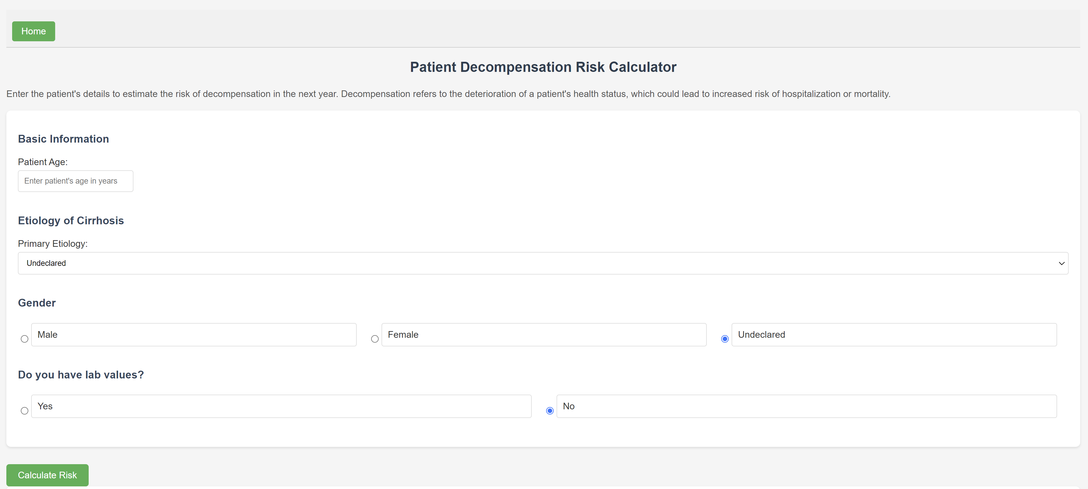
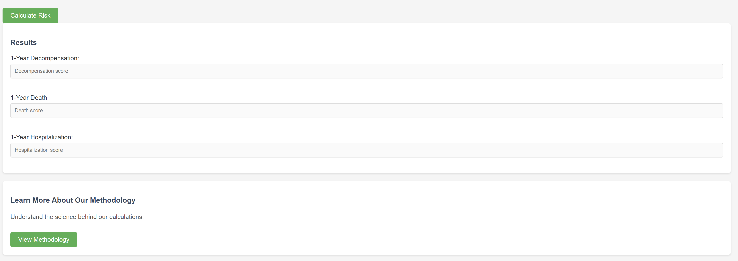
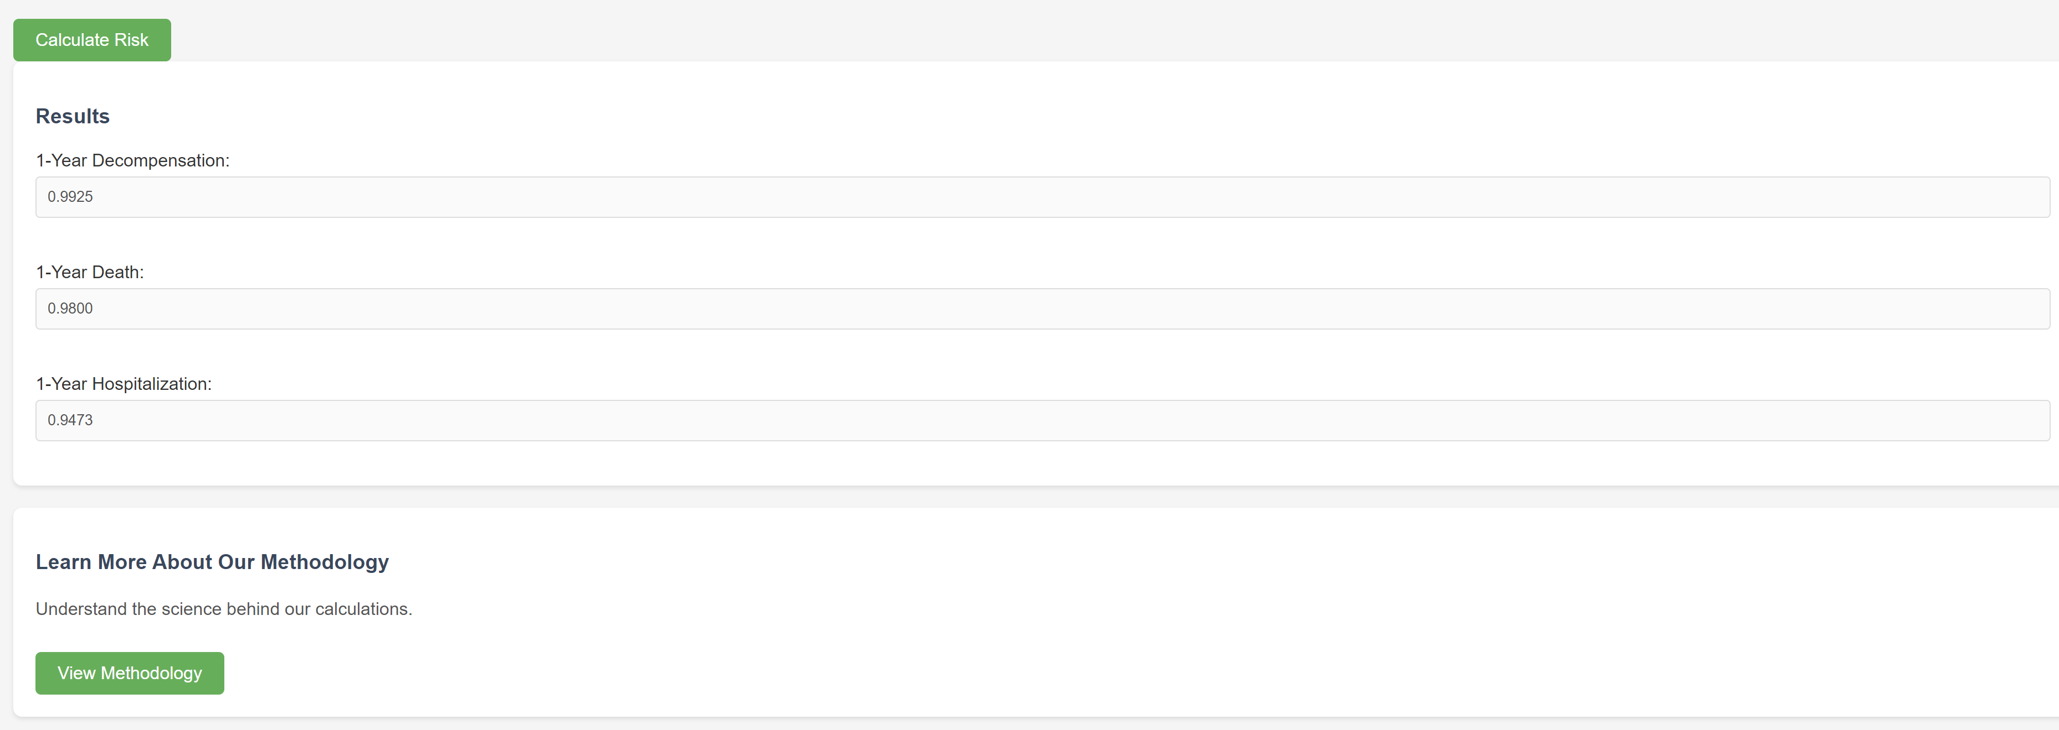
Our Outcome Calculator
Fake values
But it’s logistic regression under the hood and this website is functional
See that no covariate are declared but the outcomes are still being predicted, presumably at the average values for each covariate
Could we include patient-level costs as an outcome variable?

Slide 20
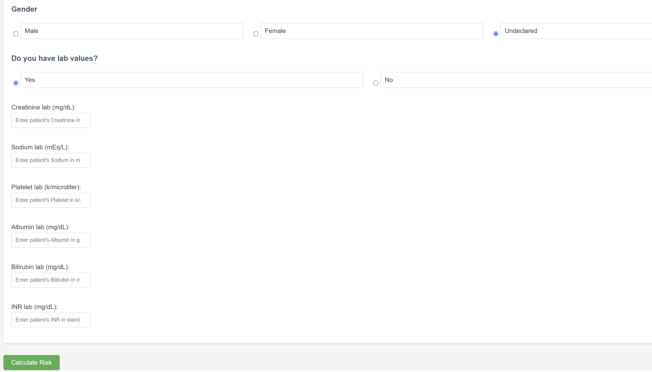
Our Outcome Calculator
We can expand the calculator by saying we have lab values

Slide 21
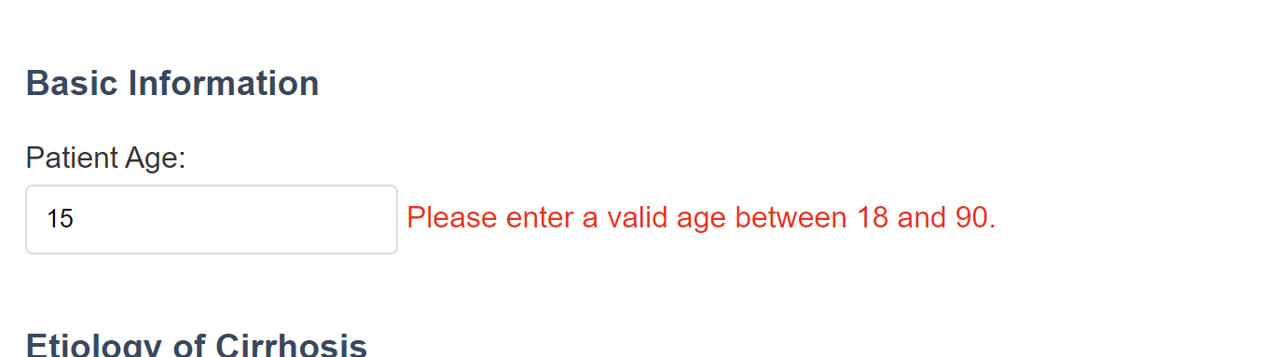
Our Outcome Calculator
We can expand the calculator by saying we have lab values
We can add error messages and what not, these are second order importance… but need to be done

Slide 22
Next Steps
What do we want this website to do?
What would make this website valuable to clinicians?
What visual design do we want?
Who will create the “text” for the website… Gil can create a version 0, but many calculators include information on how these results can be used… and I don’t really trust Gil to give advice to physicians. “I’m not a doctor, but I play one on TV.”

